Slide 1
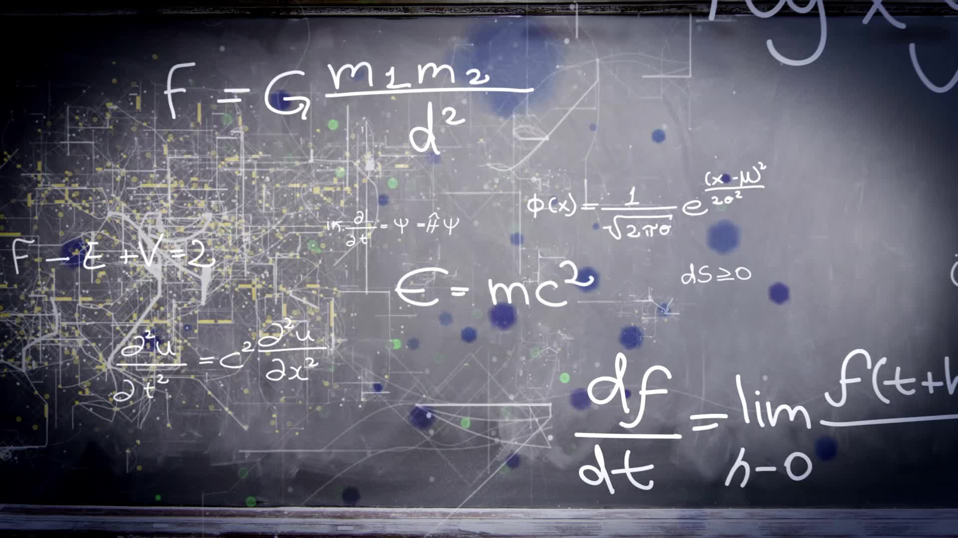
Chapter 3.7:
Optimization Problems
HONORS CALCULUS/CALCULUS

Slide 2
Procedures for Solving Applied Minimum and Maximum Problems
Assign symbols to all given quantities and quantities to be determined.
Write a primary equation for the quantity to be maximized or minimized.
Reduce the primary equation to one having a single independent variable. This may involve the use of a secondary equation.
Determine the domain. Make sure it makes sense.
Determine the mad and min by differentiation.

Slide 3
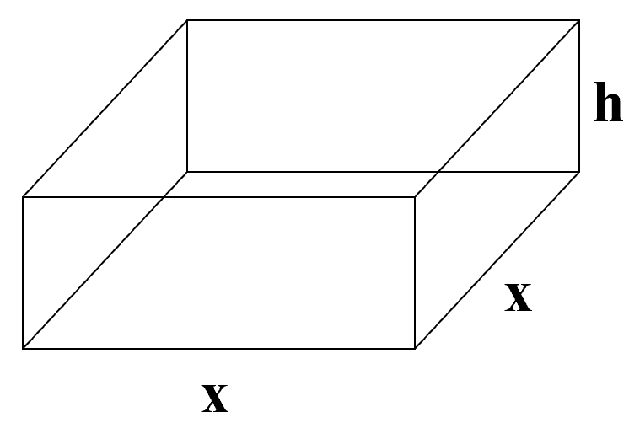







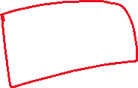

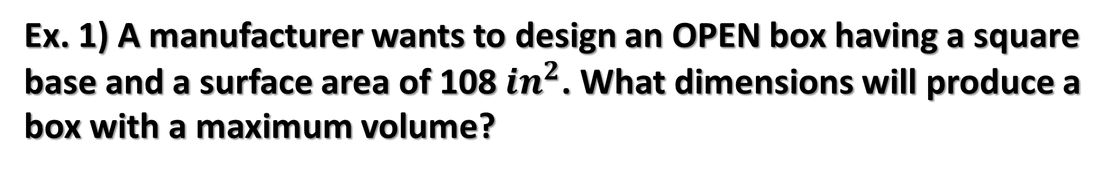






Ex. 1) A manufacturer wants to design an OPEN box having a square base and a surface area of 108 $in^{2}$. What dimensions will produce a box with a maximum volume?

Slide 4


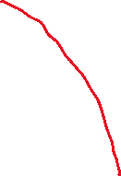




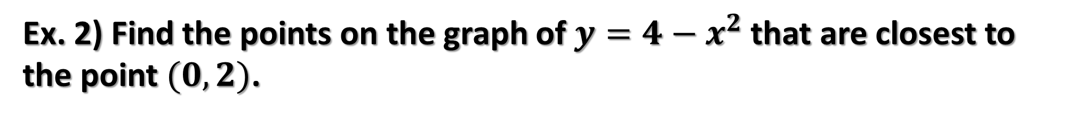
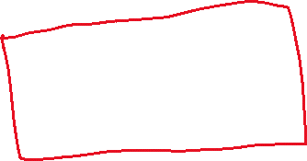
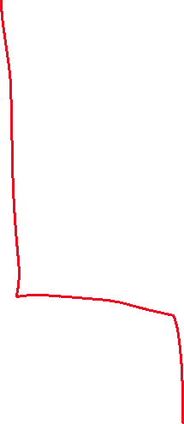












Ex. 2) Find the points on the graph of $y=4−x^{2}$ that are closest to the point $(0,2)$.

Slide 5









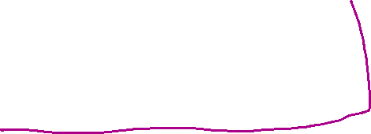










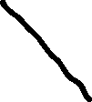
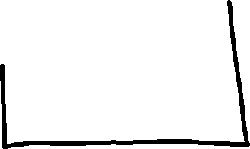



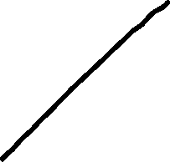



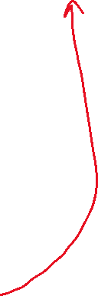


Ex. 3) Two posts, one 12 feet high and the other 28 feet high, stand 30 feet apart. They are to be stayed by two wires, attached to a single stake, running from ground level to the top of each post. Where should the stake be placed to use the least amount of wire?

Slide 6












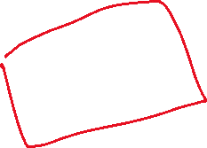



Ex. 4) An open box of a maximum volume is to be made from a square piece of material. 24 inches on a side, by cutting equal squares from the corners and turning up the sides. Find the dimensions which will produce a box having the largest possible volume.

